Slide 1

Emerging Technologies
Session #03: Using bluemix to deploy a first application
IBM Bluemix
The Digital Innovation Platform
Sylvain-Roch WILBERT
s_wilbert@fr.ibm.com
Université Paris - Dauphine

Slide 2
Objectives of the session
Open your Bluemix account
Using Regions, spaces
Deploying a new nodeJS application in the cloud
Access to the application code

Slide 3
Your mission
Your mission, should you choose/decide to accept it, is to
deploy a node js application accessible on the internet
…in less than 5 minutes

Slide 4
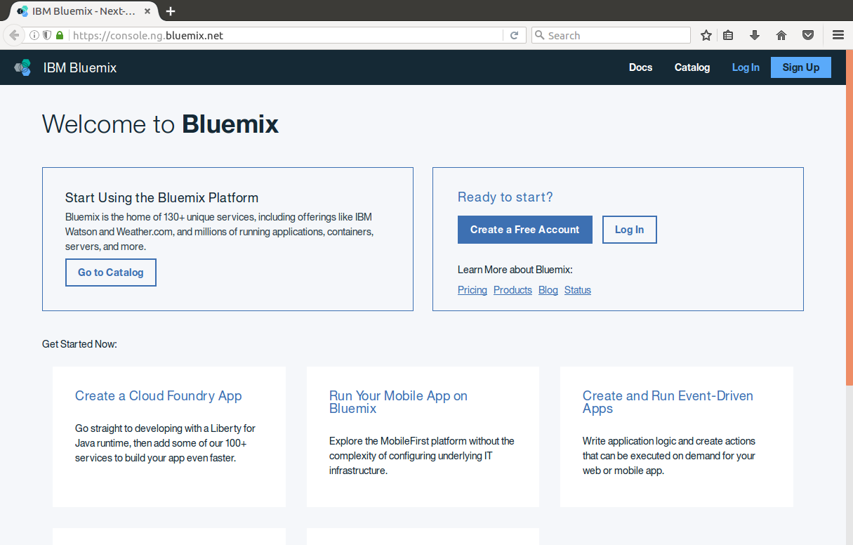
Open the US south console and login

Slide 5
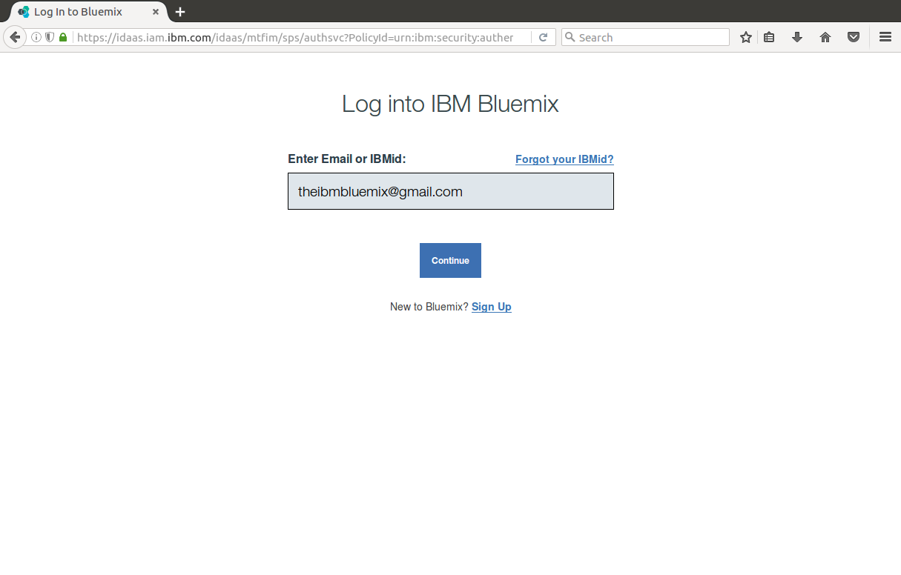

1
Enter your email
Click on

Slide 6
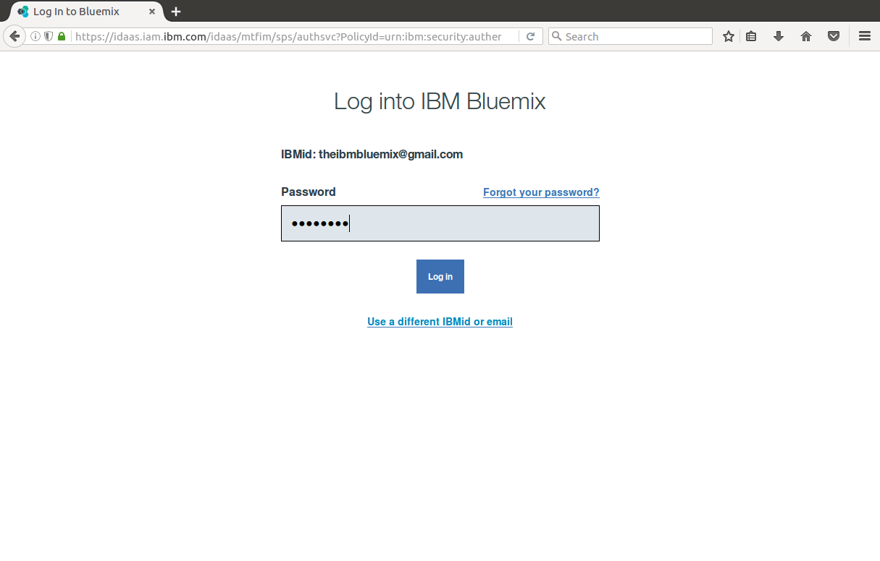

2
Enter your password
Click on

Slide 7
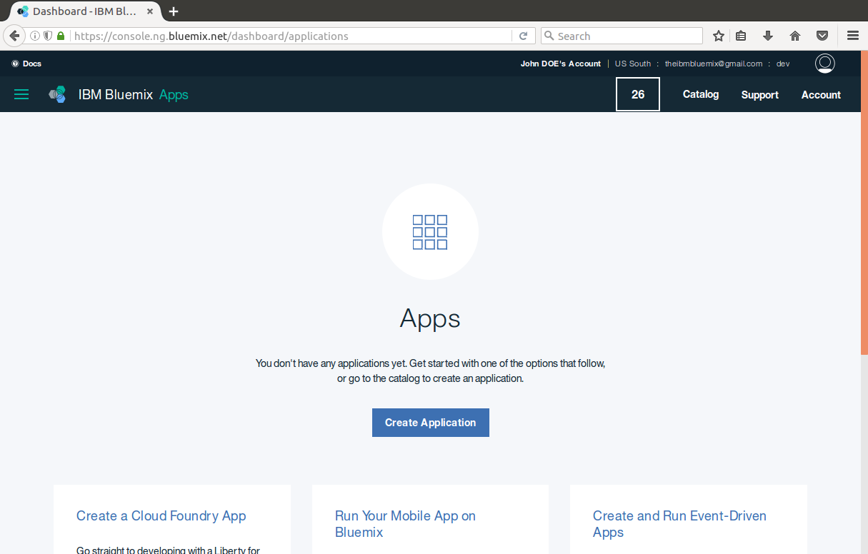

Create your application by clicking on
Remark
Zone : US South
Organization : youremail
Space: dev

Slide 8
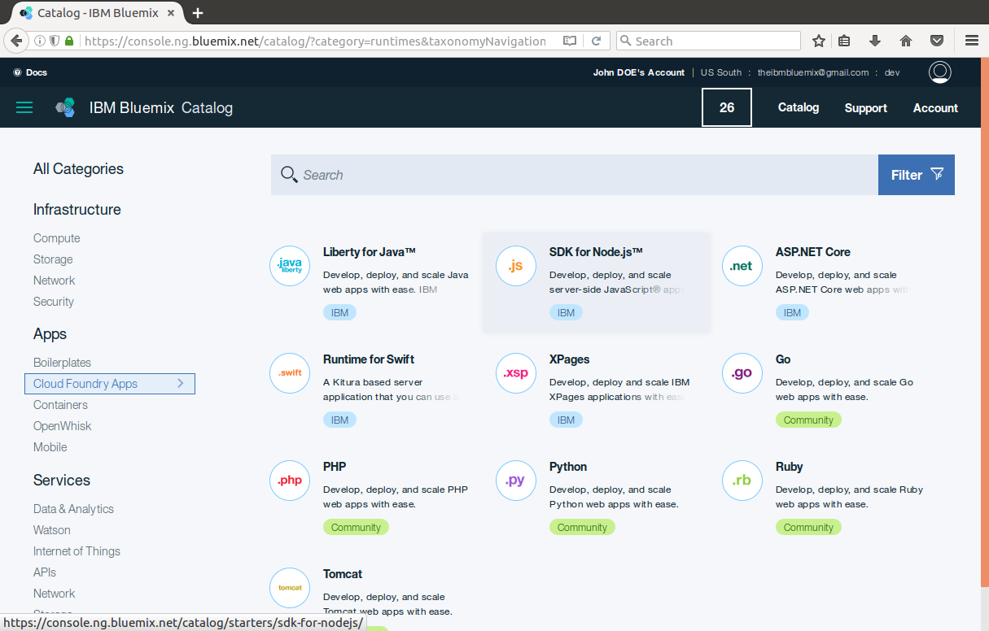
2
1
Browse the catalog
Select the Cloud Foundry apps
SELECT SDK (SOFTWARE DEVELOPMENT KIT) for Node JS

Slide 9
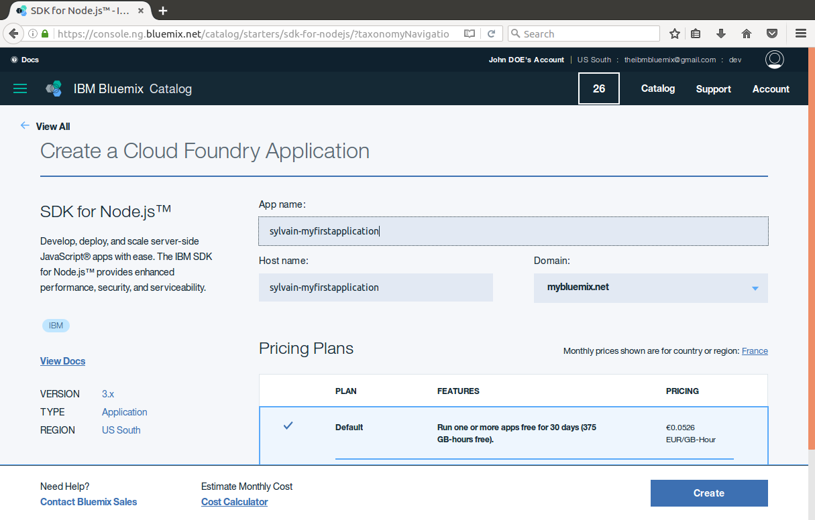

1
Enter a worldwide unique application name ( prefer lower case)
Click on

Slide 10
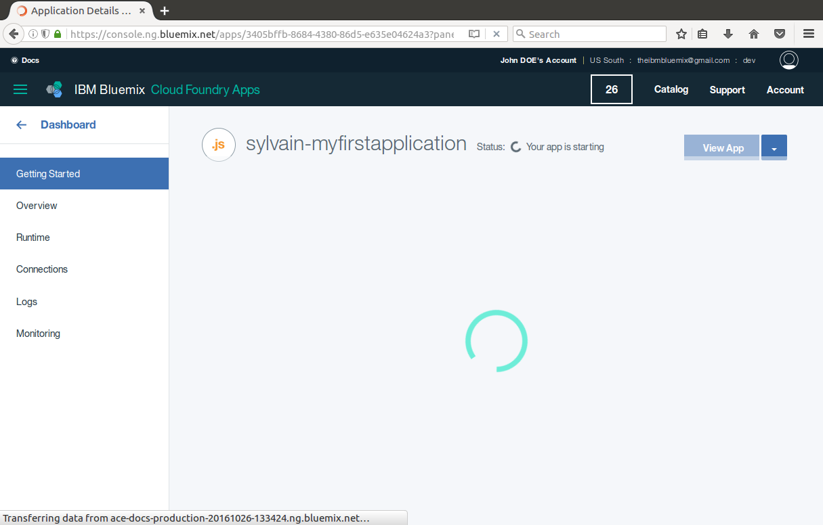
Creating the app…

Slide 11
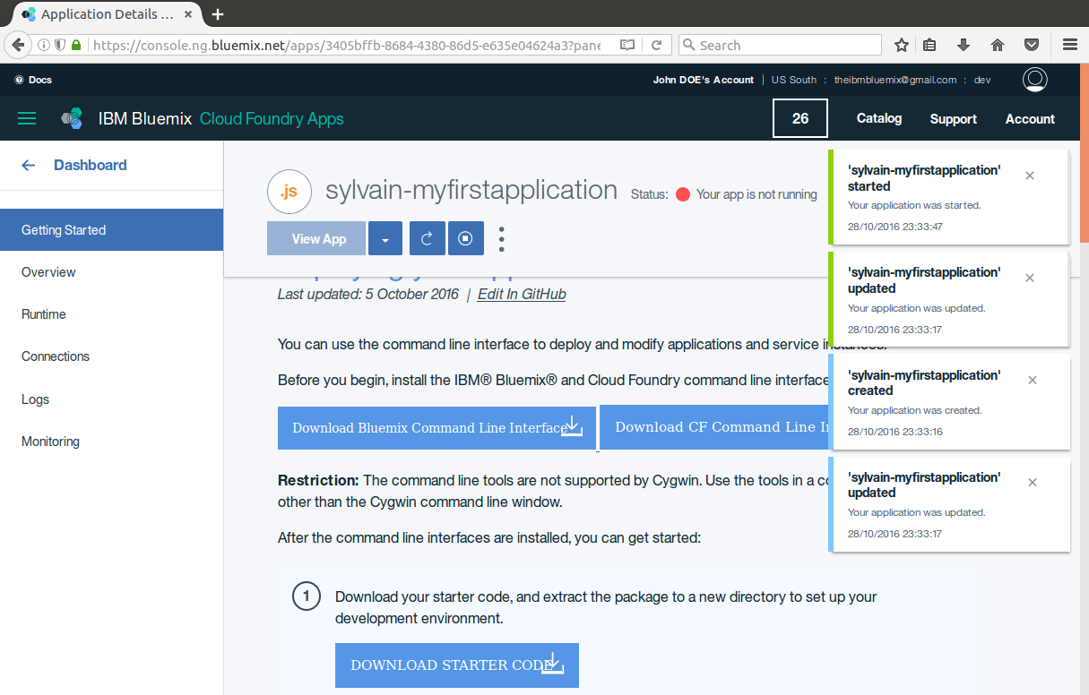
Deploying you application

Slide 12
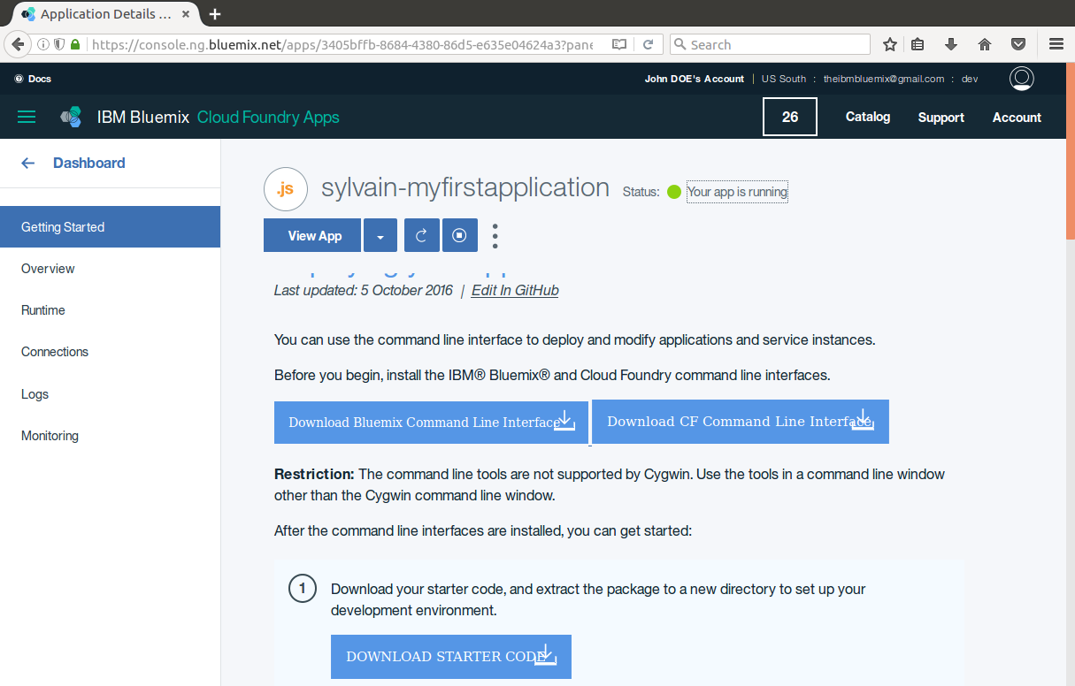

1
2
Your application is up and running
Access it by clicking on

Slide 13
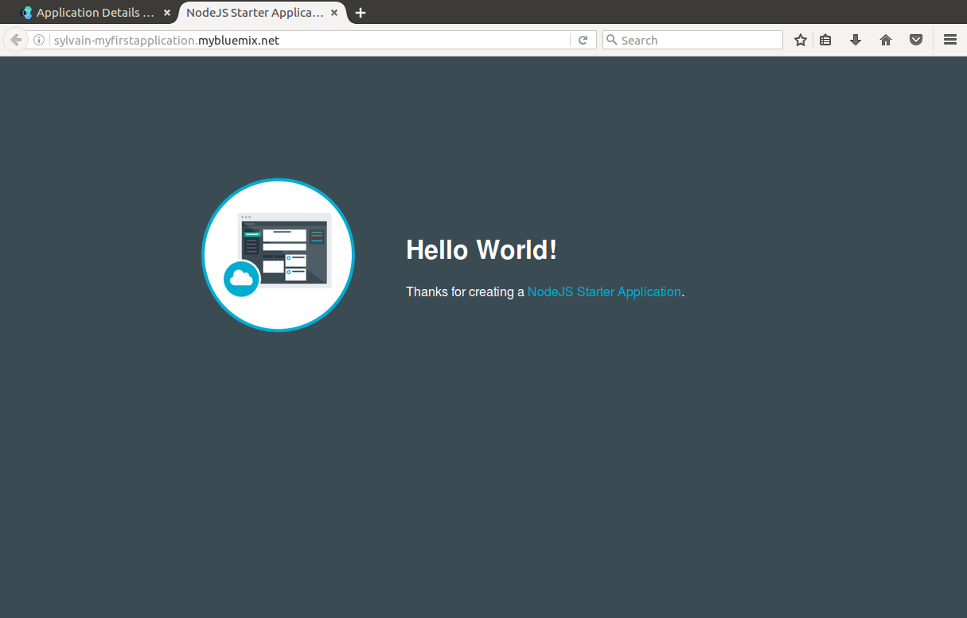
Et voila
You are Live! on the web

Slide 14
Playtime
On your mark, ready, set, go !!
You have 5 minutes to deploy your first nodeJS application on the internet ….

Slide 15
Your mission
Your mission, should you choose/decide to accept it, is to
Access the configuration of your servers
Update the code of your application

Slide 16
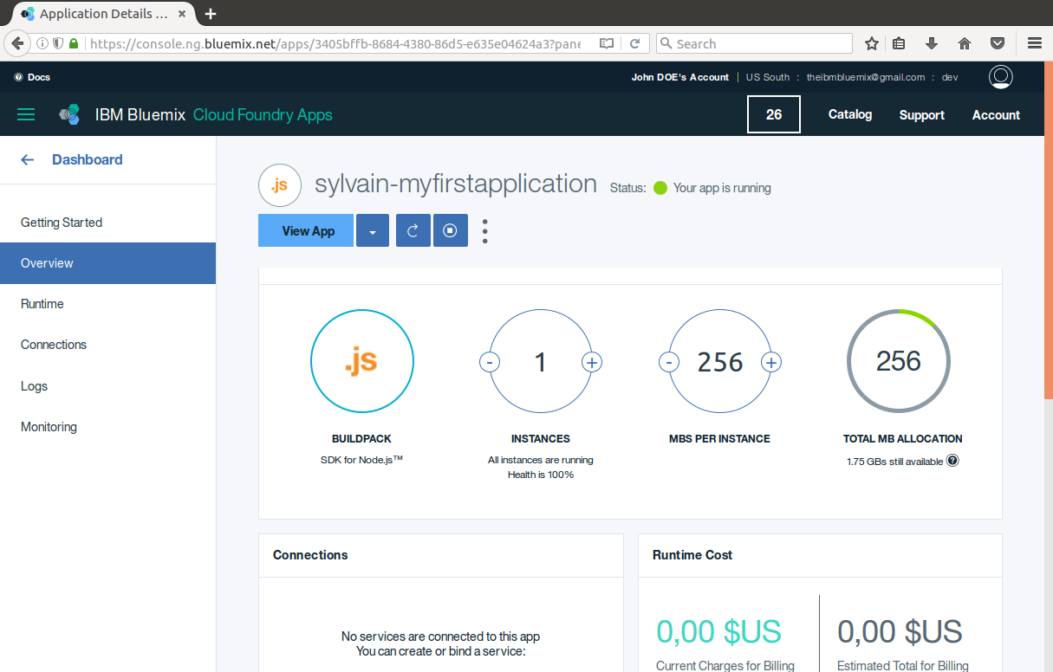

Monitoring my application
Click on
Instance : Processing capacity
MB Dedicated Memory per instance
Click on and What happens ?

Slide 17
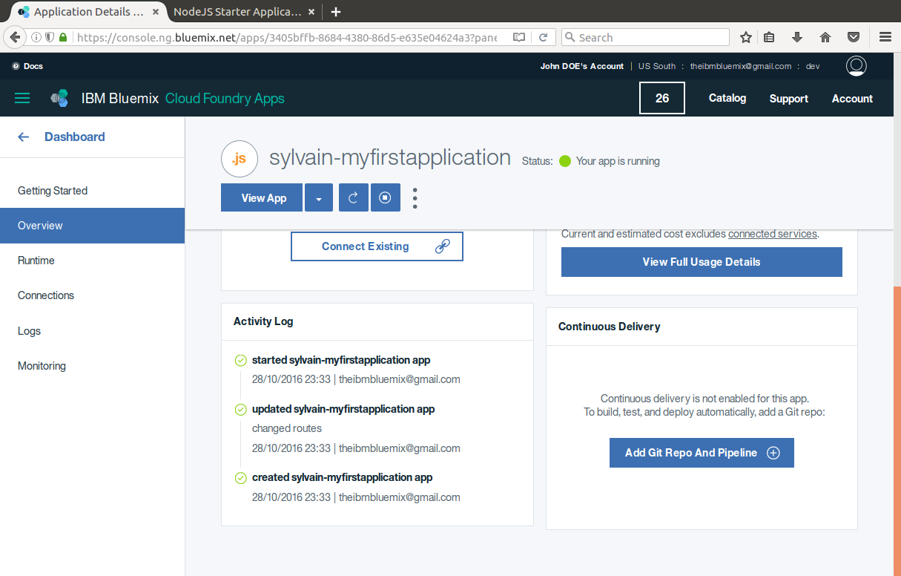
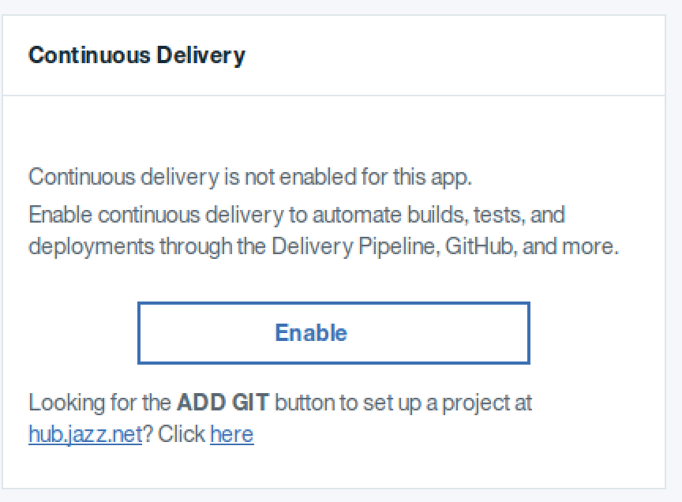

Continuous delivery
LAST Minute: GUI has evolved
Scroll down the page to Continuous Delivery
Click on

Slide 18
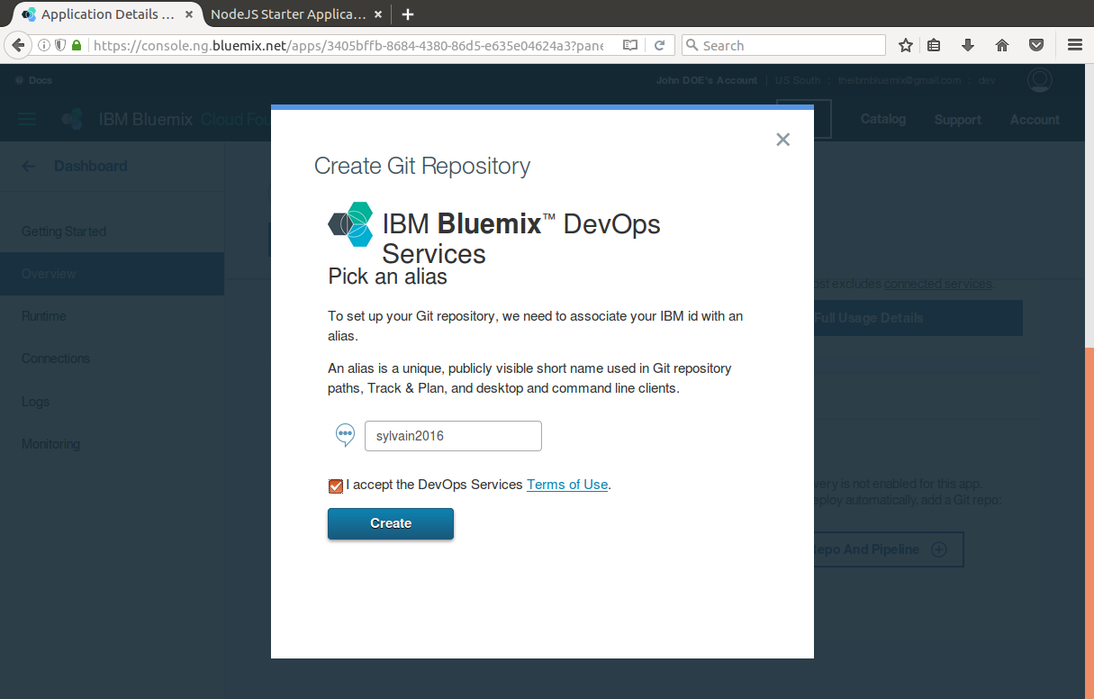

Enter a unique Alias identifying your Git Repo
Click on

Slide 19
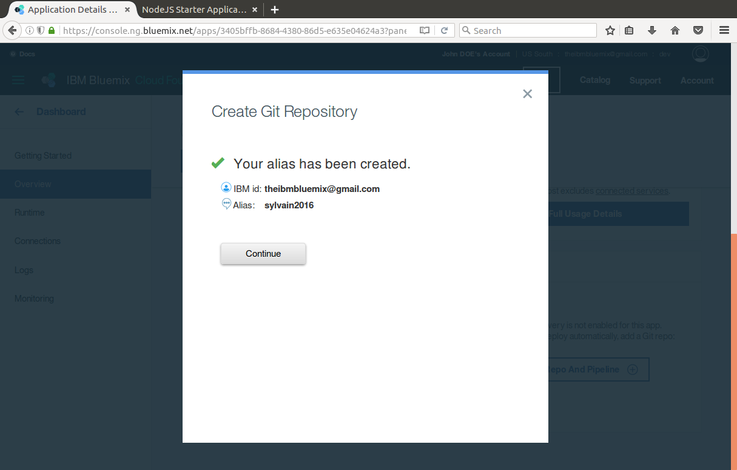

Click on

Slide 20
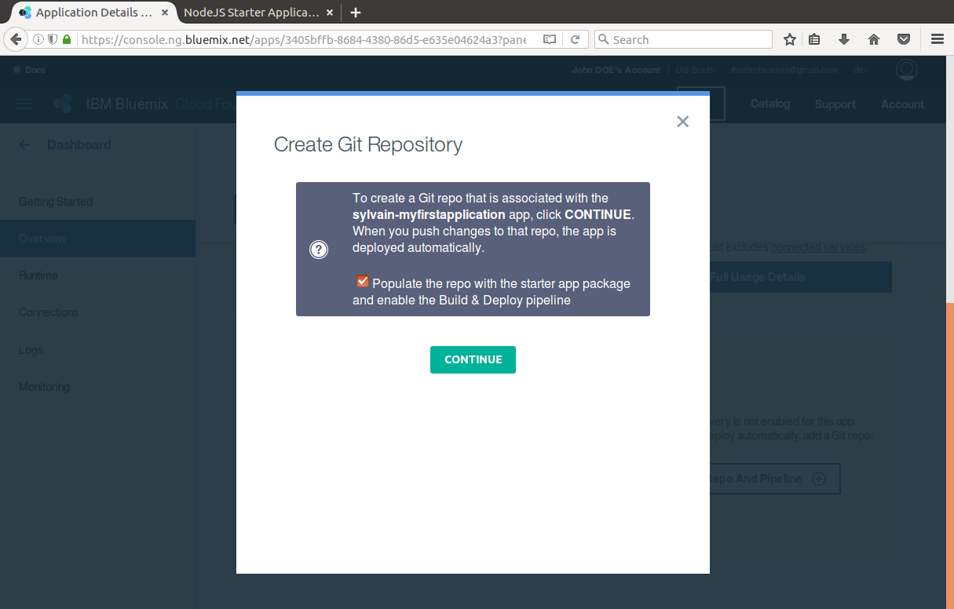

Add your application to the GIT repo
Click on

Slide 21
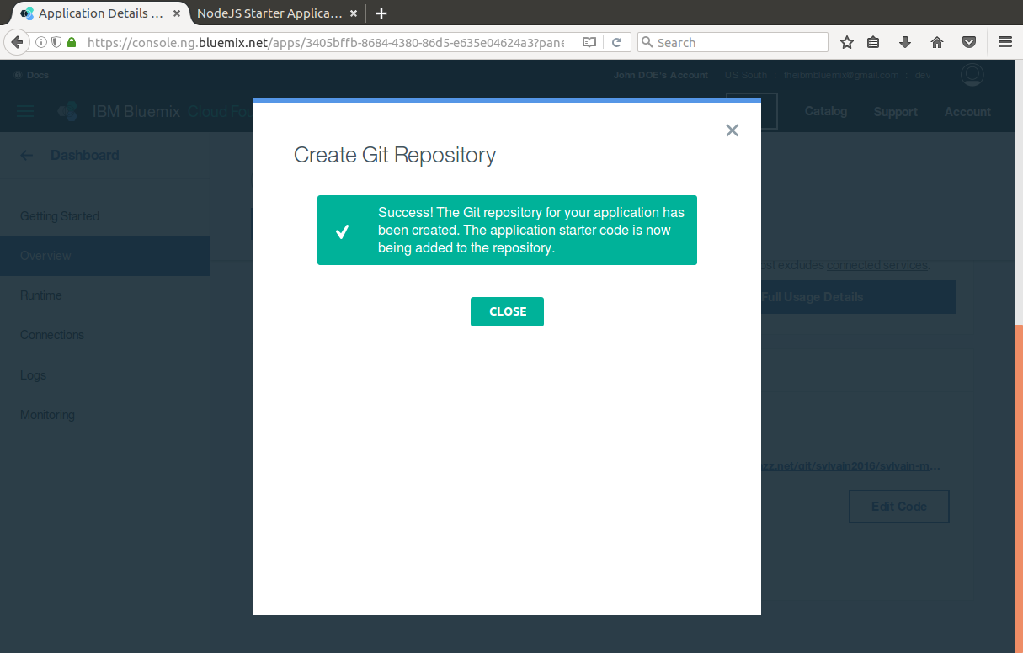

Done !
Click on

Slide 22
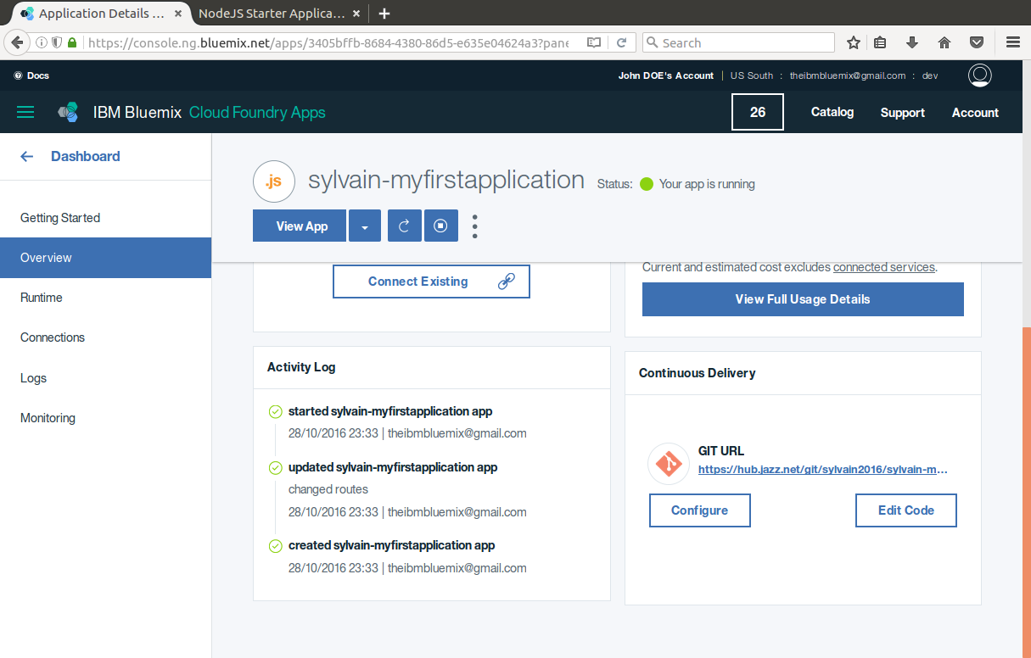
The Continuous delivery section has change

Slide 23
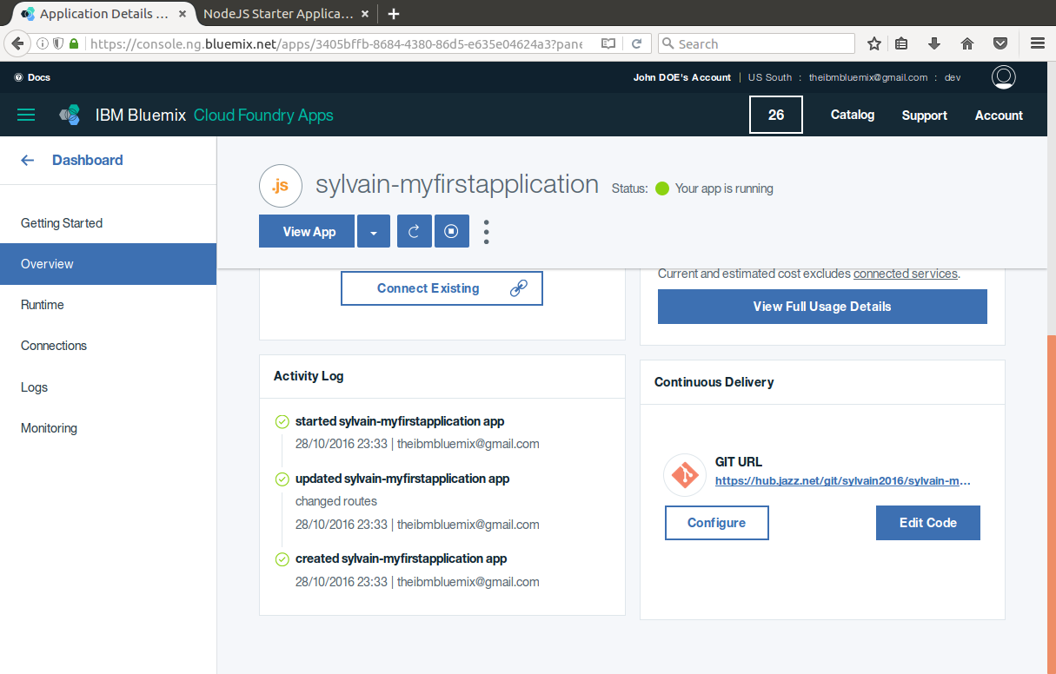

Done !
Click on

Slide 24
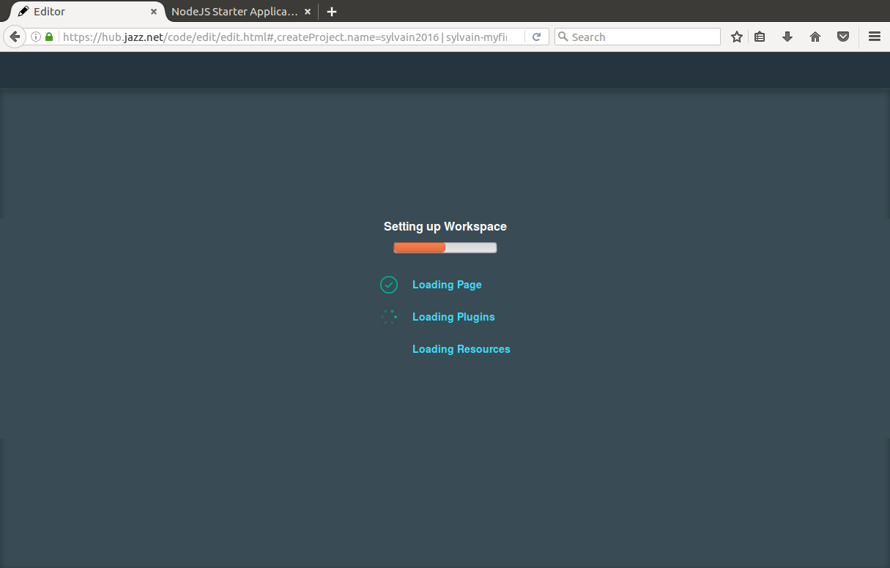
Teasing…. Something is preparing…

Slide 25
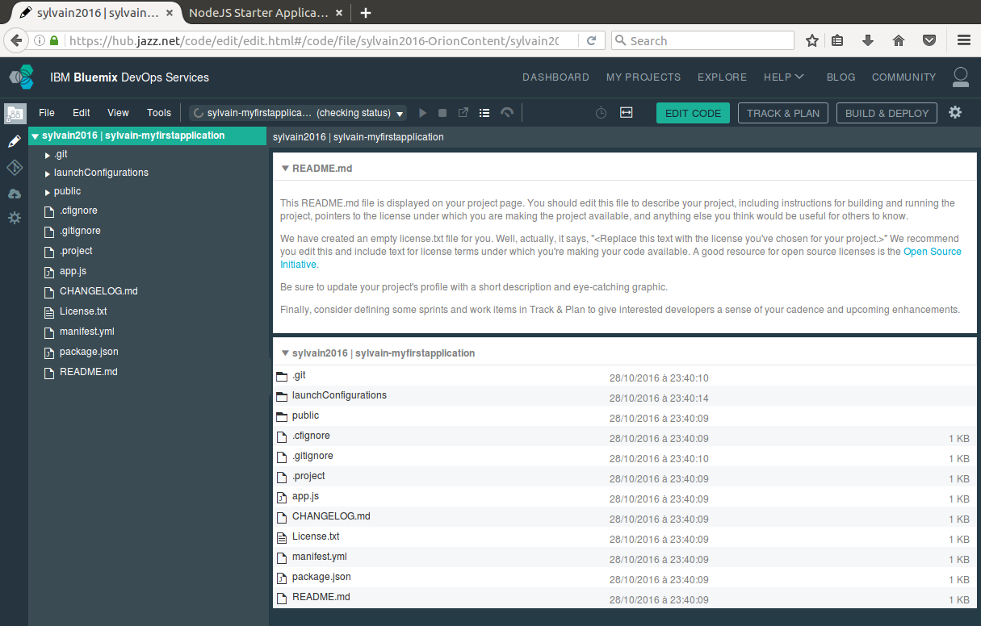
My development environment is set up.

Slide 26
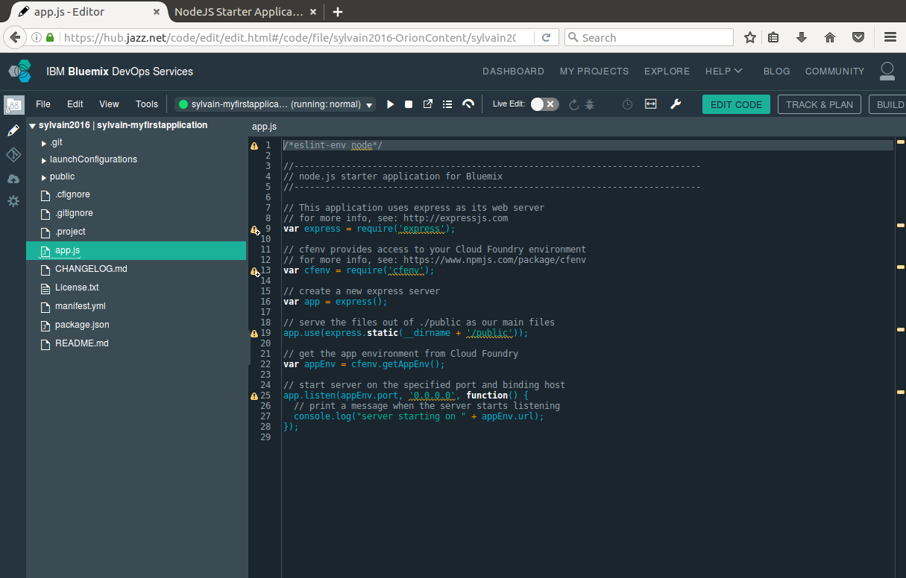
The code

Slide 27
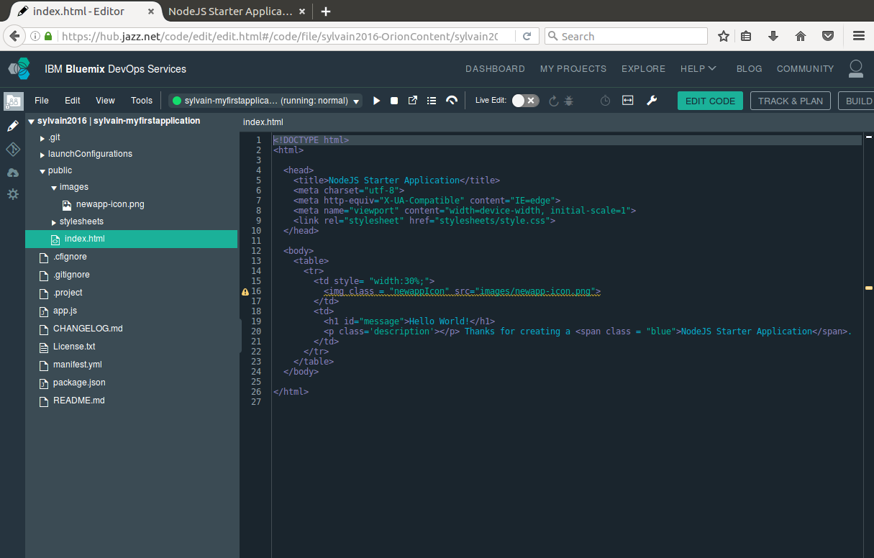
The page displayed

